Slide 1
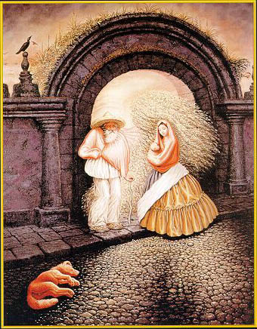
Image Segmentation
Computer Vision
Jia-Bin Huang, Virginia Tech
Many slides from D. Hoiem

Slide 2
Administrative stuffs
HW 3 due 11:59 PM, Oct 17 (Wed)
Final project proposal due Oct 23 (Mon)
Title
Problem
Tentative approach
Evaluation
References

Slide 3
Today’s class
Review/finish Structure from motion
Multi-view stereo
Segmentation and grouping
Gestalt cues
By clustering (k-means, mean-shift)
By boundaries (watershed)
By graph (merging , graph cuts)
By labeling (MRF) <- Next Thursday
Superpixels and multiple segmentations

Slide 4
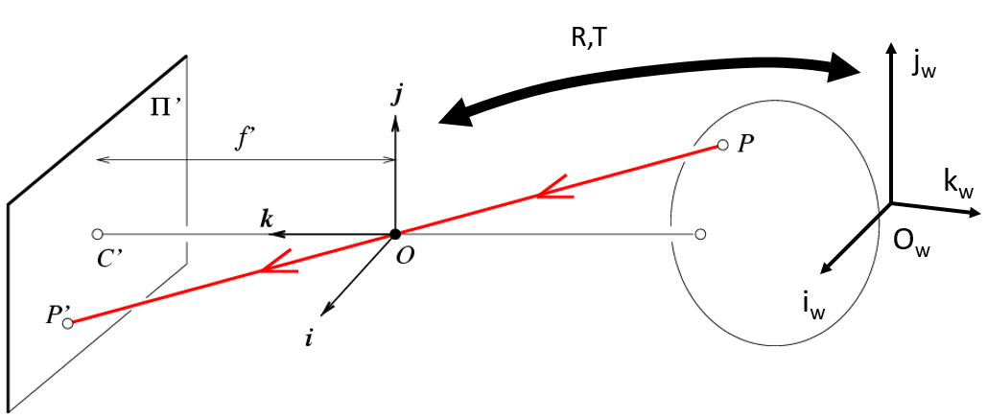
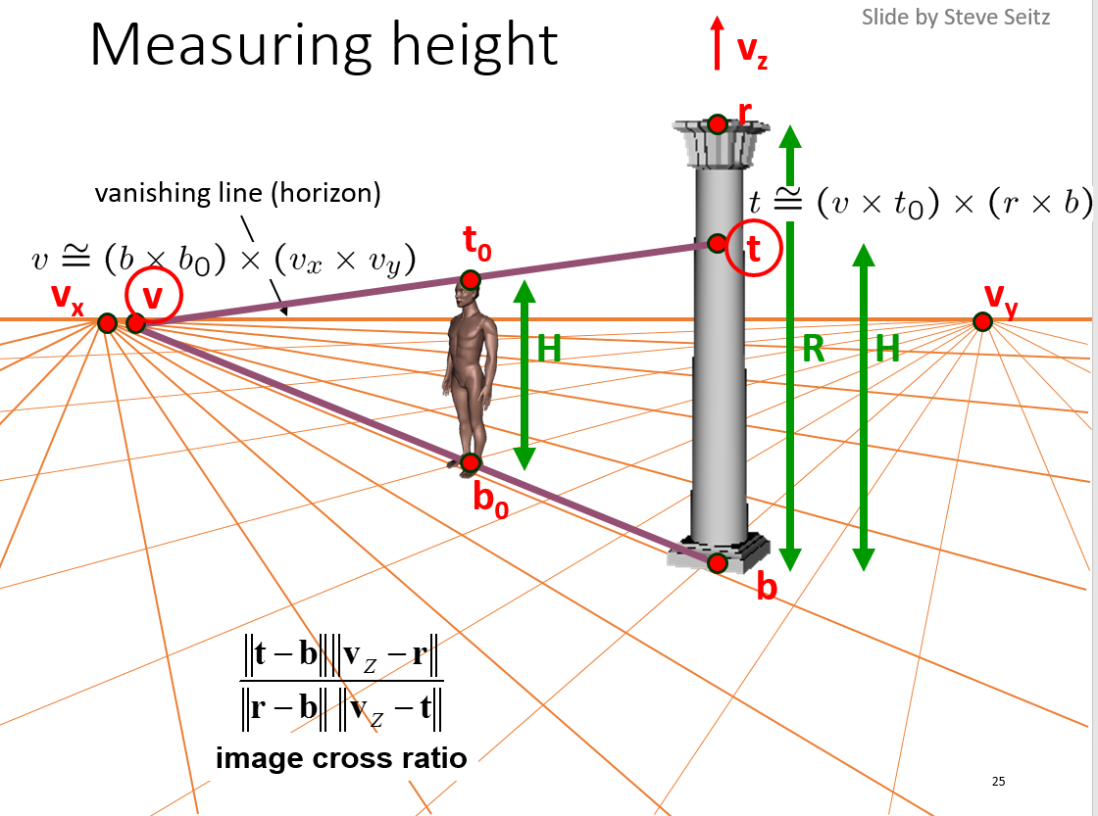
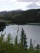
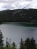
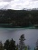
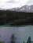
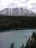
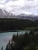
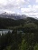
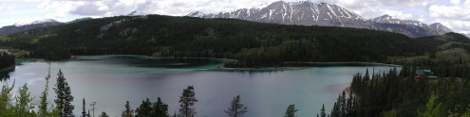
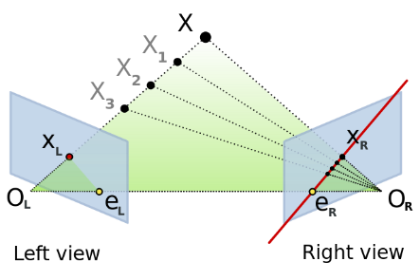
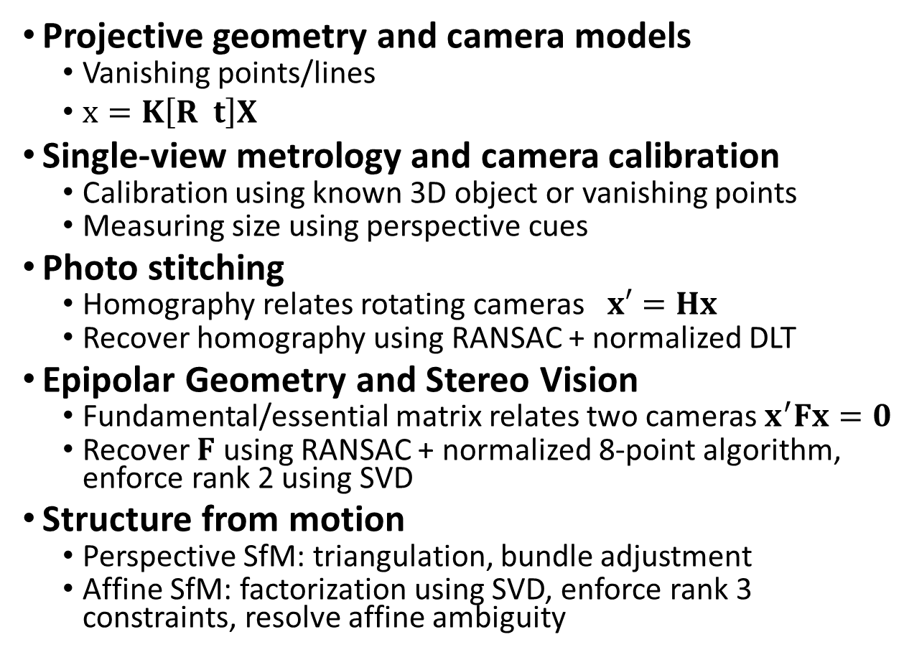
Perspective and 3D Geometry
Projective geometry and camera models
Vanishing points/lines
$x=K\left[R t\right]X$
Single-view metrology and camera calibration
Calibration using known 3D object or vanishing points
Measuring size using perspective cues
Photo stitching
Homography relates rotating cameras $x′=Hx$
Recover homography using RANSAC + normalized DLT
Epipolar Geometry and Stereo Vision
Fundamental/essential matrix relates two cameras $x^{′}Fx=0$
Recover $F$ using RANSAC + normalized 8-point algorithm, enforce rank 2 using SVD
Structure from motion
Perspective SfM: triangulation, bundle adjustment
Affine SfM: factorization using SVD, enforce rank 3 constraints, resolve affine ambiguity
X_{j}
x_{1j}
x_{3j}
P₁
x_{2j}
P₂
P₃

Slide 5
Review: Projective structure from motion
Given: m images of n fixed 3D points
x_{ij} = P_{i} X_{j} , i = 1,… , m, j = 1, … , n
Problem: estimate m projection matrices P_{i} and n 3D points X_{j} from the mn corresponding 2D points x_{ij}
X_{j}
x_{1j}
x_{3j}
x_{2j}
P₁
P₃
P₂
Slides: Lana Lazebnik

Slide 6
Review: Affine structure from motion
Given: m images and n tracked features x_{ij}
For each image i, center the feature coordinates
Construct a 2m × n measurement matrix D:
Column j contains the projection of point j in all views
Row i contains one coordinate of the projections of all the n points in image i
Factorize D:
Compute SVD: D = U W V^{T}
Create U₃ by taking the first 3 columns of U
Create V₃ by taking the first 3 columns of V
Create W₃ by taking the upper left 3 × 3 block of W
Create the motion (affine) and shape (3D) matrices:
A = U₃W₃^{½} and S = W₃^{½} V₃^{T}
Eliminate affine ambiguity
Solve L = CC^{T} using metric constraints
Solve C using Cholesky decomposition
Update A and X: A = AC, S = C⁻¹S
Source: M. Hebert

Slide 7
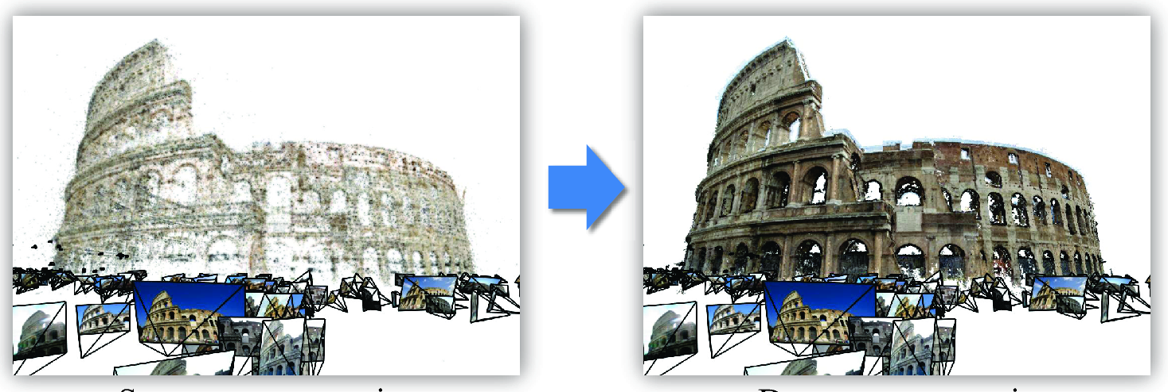
Multi-view stereo

Slide 8
Multi-view stereo
Generic problem formulation: given several images of the same object or scene, compute a representation of its 3D shape
“Images of the same object or scene”
Arbitrary number of images (from two to thousands)
Arbitrary camera positions (special rig, camera network or video sequence)
Calibration may be known or unknown
“Representation of 3D shape”
Depth maps
Meshes
Point clouds
Patch clouds
Volumetric models
….

Slide 9
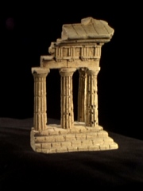
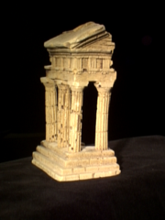
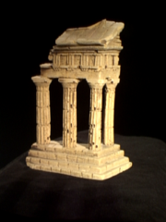
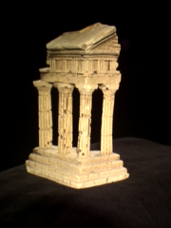
Multi-view stereo: Basic idea
Source: Y. Furukawa

Slide 10
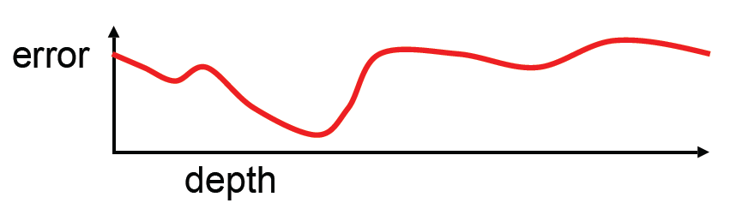
Multi-view stereo: Basic idea
Source: Y. Furukawa

Slide 11
Multi-view stereo: Basic idea
Source: Y. Furukawa

Slide 12
Multi-view stereo: Basic idea
Source: Y. Furukawa

Slide 13
Plane Sweep Stereo
input image
input image
reference camera
Sweep family of planes at different depths w.r.t. a reference camera
For each depth, project each input image onto that plane
This is equivalent to a homography warping each input image into the reference view
What can we say about the scene points that are at the right depth?
R. Collins. A space-sweep approach to true multi-image matching. CVPR 1996.

Slide 14
Plane Sweep Stereo
Scene surface
Sweeping plane
Image 2
Image 1

Slide 15
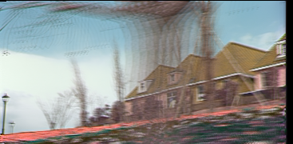
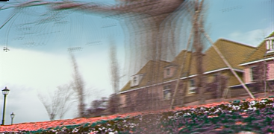
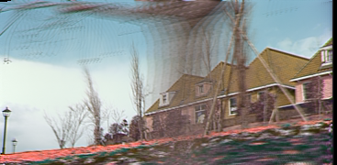
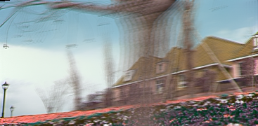
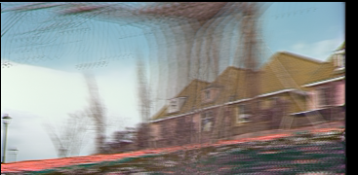
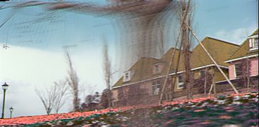
Plane Sweep Stereo
For each depth plane
For each pixel in the composite image stack, compute the variance
For each pixel, select the depth that gives the lowest variance
Can be accelerated using graphics hardware
R. Yang and M. Pollefeys. Multi-Resolution Real-Time Stereo on Commodity Graphics Hardware, CVPR 2003

Slide 16
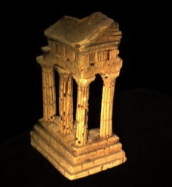
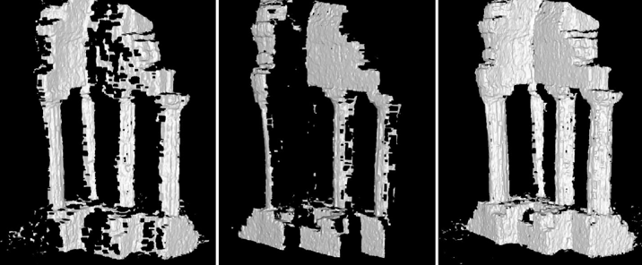
Merging depth maps
Given a group of images, choose each one as reference and compute a depth map w.r.t. that view using a multi-baseline approach
Merge multiple depth maps to a volume or a mesh (see, e.g., Curless and Levoy 96)
Map 1
Map 2
Merged

Slide 17
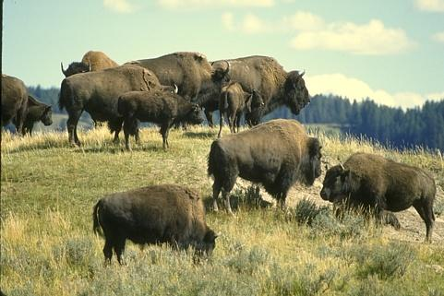
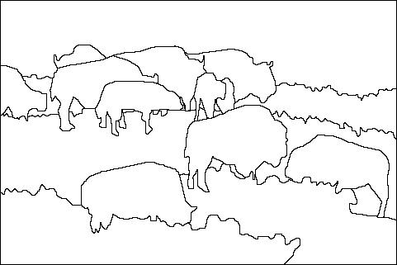
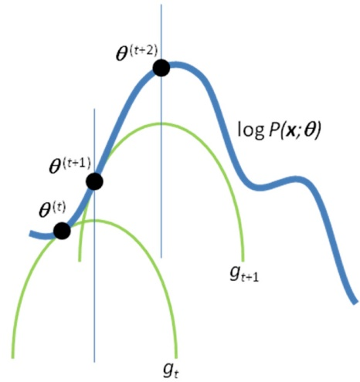
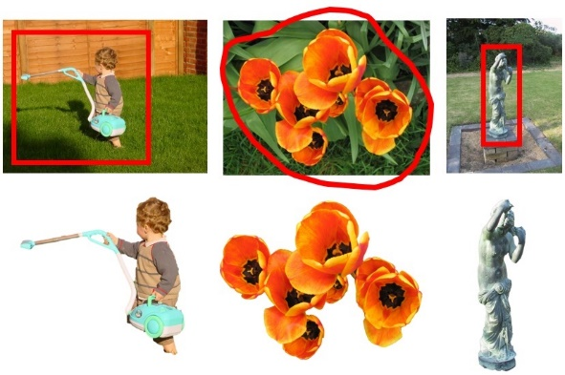
Grouping and Segmentation
Image Segmentation
Which pixels belong together?
Hidden Variables, the EM Algorithm, and Mixtures of Gaussians
How to handle missing data?
MRFs and Segmentation with Graph Cut
How do we solve image labeling problems?

Slide 18
How many people?

Slide 19
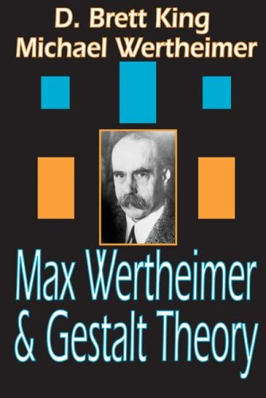
Gestalt psychology or gestaltism
German: Gestalt - "form" or "whole”
Berlin School, early 20th century
Kurt Koffka, Max Wertheimer, and Wolfgang Köhler
View of brain:
whole is more than the sum of its parts
holistic
parallel
analog
self-organizing tendencies
Slide from S. Saverese

Slide 20
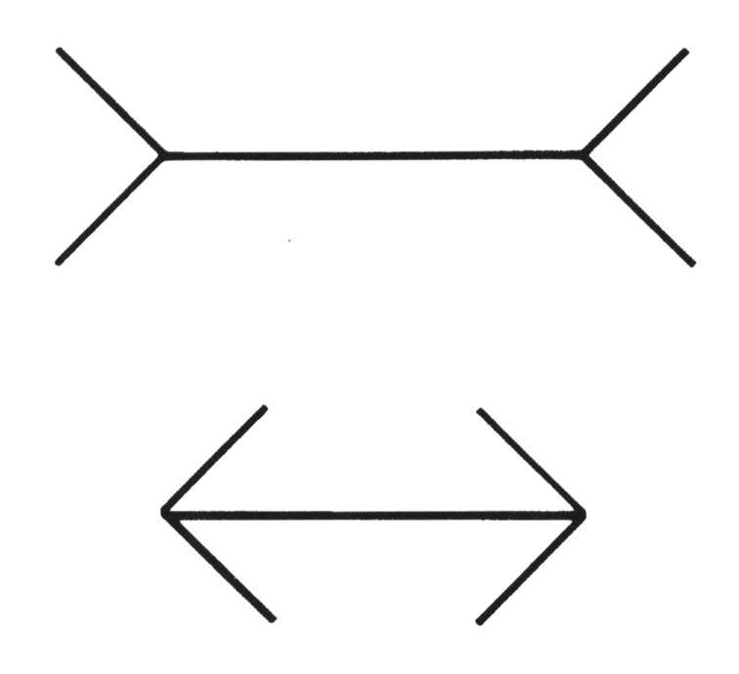
Gestaltism
The Muller-Lyer illusion
Notes:
The famous Muller-Lyer illusion; the point is that the horizontal bar has properties that come only from its membership in
a group (it looks shorter in the lower picture, but is actually the same size) and that these properties can’t be discounted--- you can’t look at this figure and ignore the arrowheads and thereby make the two bars seem to be the same size.

Slide 21
We perceive the interpretation, not the senses
Notes:
In one experiment, children from rural Zambia were less susceptible to the illusion.

Slide 22
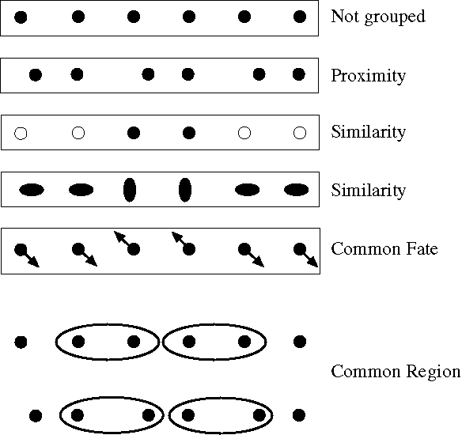
Principles of perceptual organization
From Steve Lehar: The Constructive Aspect of Visual Perception
Notes:
Some criteria that tend to cause tokens to be grouped.

Slide 23
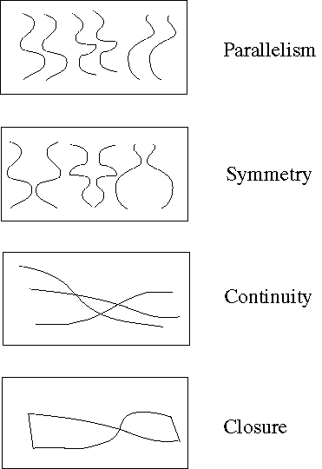
Principles of perceptual organization
Notes:
More such

Slide 24
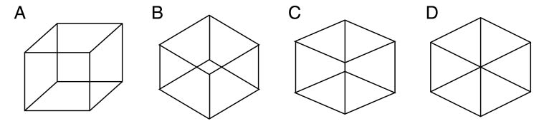
Gestaltists do not believe in coincidence

Slide 25
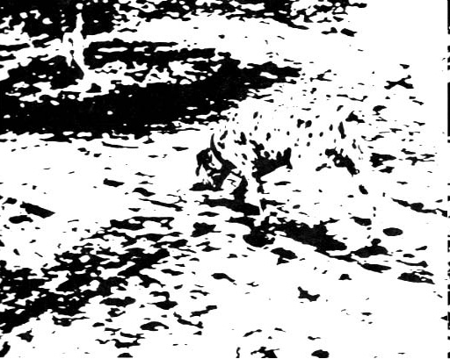
Emergence

Slide 26
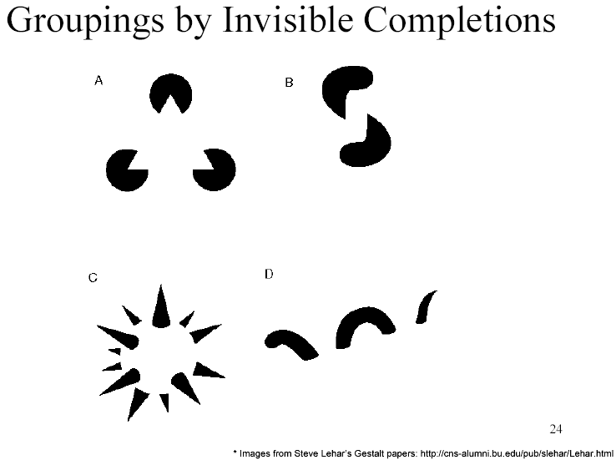
Grouping by invisible completion
From Steve Lehar: The Constructive Aspect of Visual Perception

Slide 27
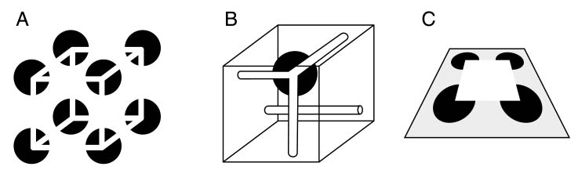
Grouping involves global interpretation
From Steve Lehar: The Constructive Aspect of Visual Perception

Slide 28
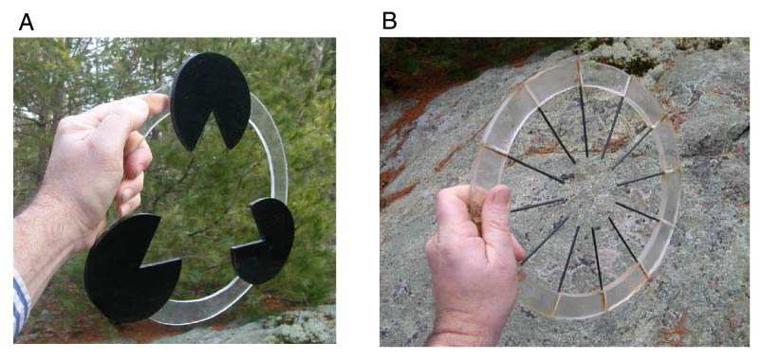
Grouping involves global interpretation
From Steve Lehar: The Constructive Aspect of Visual Perception

Slide 29
Gestalt cues
Good intuition and basic principles for grouping
Basis for many ideas in segmentation and occlusion reasoning
Some (e.g., symmetry) are difficult to implement in practice

Slide 30
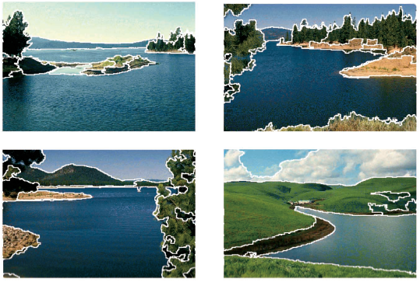
Image segmentation
Goal: Group pixels into meaningful or perceptually similar regions

Slide 31
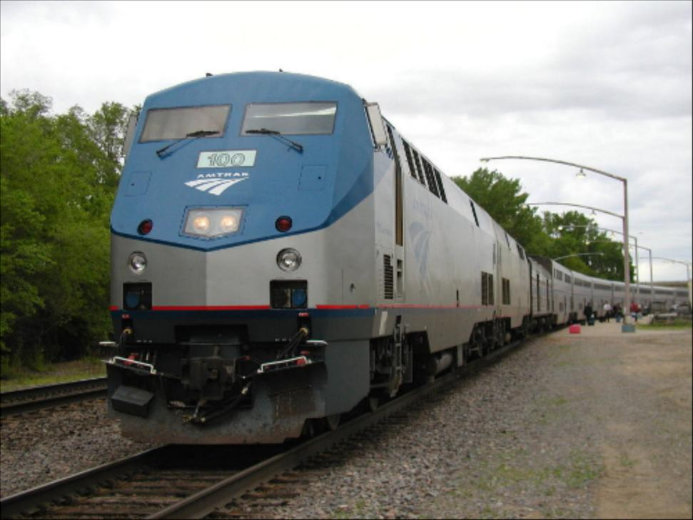
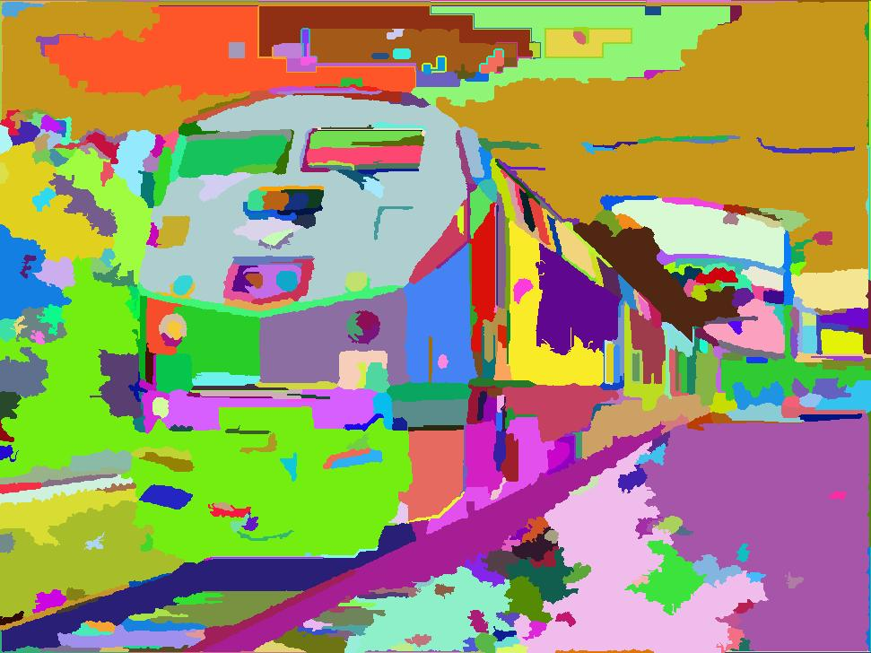
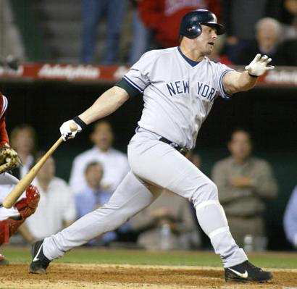
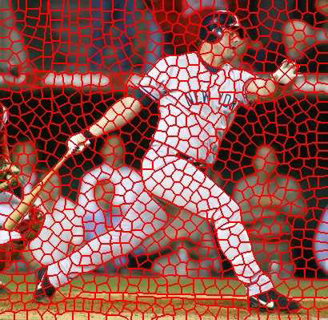
Segmentation for efficiency: “superpixels”
[Felzenszwalb and Huttenlocher 2004]
[Shi and Malik 2001]
[Hoiem et al. 2005, Mori 2005]

Slide 32
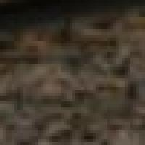
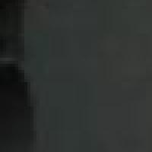
Segmentation for feature support
50x50 Patch
50x50 Patch

Slide 33
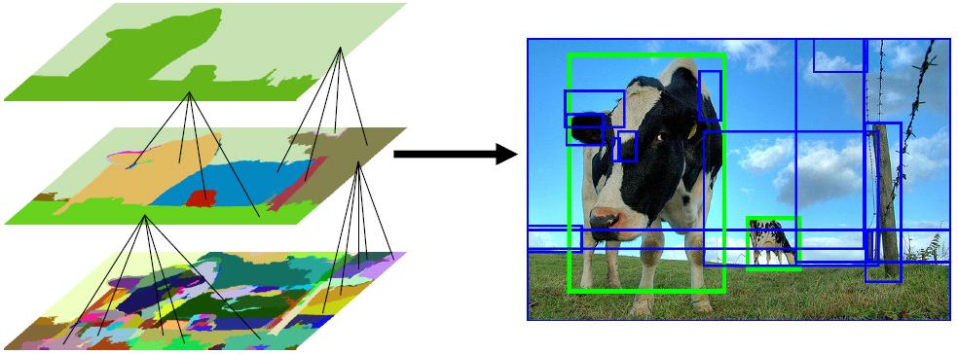
Segmentation for object proposals
“Selective Search” [Sande, Uijlings et al. ICCV 2011, IJCV 2013]
[Endres Hoiem ECCV 2010, IJCV 2014]

Slide 34
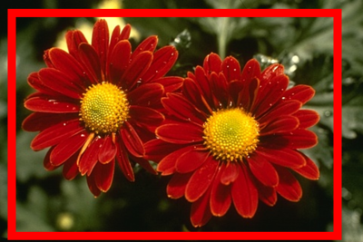
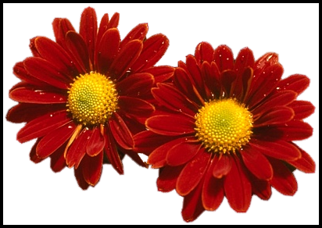


Segmentation as a result
Rother et al. 2004

Slide 35

Major processes for segmentation
Bottom-up: group tokens with similar features
Top-down: group tokens that likely belong to the same object
[Levin and Weiss 2006]

Slide 36
Segmentation using clustering
Kmeans
Mean-shift

Slide 37

Feature Space
Source: K. Grauman

Slide 38
K-means algorithm
Partition the data into K sets S = {S₁, S₂, … S_{K}} with corresponding centers μ_{i}
Partition such that variance in each partition is as low as possible

Slide 39
K-means algorithm
Partition the data into K sets S = {S₁, S₂, … S_{K}} with corresponding centers μ_{i}
Partition such that variance in each partition is as low as possible

Slide 40
K-means algorithm
Initialize K centers μ_{i} (usually randomly)
Assign each point x to its nearest center:
Update cluster centers as the mean of its members
Repeat 2-3 until convergence (t = t+1)

Slide 41
function C = kmeans(X, K)
% Initialize cluster centers to be randomly sampled points
[N, d] = size(X);
rp = randperm(N);
C = X(rp(1:K), :);
lastAssignment = zeros(N, 1);
while true
% Assign each point to nearest cluster center
bestAssignment = zeros(N, 1);
mindist = Inf*ones(N, 1);
for k = 1:K
for n = 1:N
dist = sum((X(n, :)-C(k, :)).^2);
if dist < mindist(n)
mindist(n) = dist;
bestAssignment(n) = k;
end
end
end
% break if assignment is unchanged
if all(bestAssignment==lastAssignment), break; end;
% Assign each cluster center to mean of points within it
for k = 1:K
C(k, :) = mean(X(bestAssignment==k, :));
end
end

Slide 42



K-means clustering using intensity alone and color alone
Image
Clusters on intensity
Clusters on color
Notes:
I gave each pixel the mean intensity or mean color of its cluster --- this is basically just vector quantizing the image intensities/colors. Notice that there is no requirement that clusters be spatially localized and they’re not.

Slide 43

K-Means pros and cons
Pros
Simple and fast
Easy to implement
Cons
Need to choose K
Sensitive to outliers
Usage
Rarely used for pixel segmentation

Slide 44

Mean shift segmentation
D. Comaniciu and P. Meer, Mean Shift: A Robust Approach toward Feature Space Analysis, PAMI 2002.
Versatile technique for clustering-based segmentation

Slide 45



Mean shift algorithm
Try to find modes of this non-parametric density

Slide 46

Kernel density estimation
Kernel
Estimated density
Data (1-D)

Slide 47


Kernel density estimation
Kernel density estimation function
Gaussian kernel

Slide 48
Mean shift
Region of
interest
Center of
mass
Mean Shift
vector
Slide by Y. Ukrainitz & B. Sarel

Slide 49
Mean shift
Region of
interest
Center of
mass
Mean Shift
vector
Slide by Y. Ukrainitz & B. Sarel

Slide 50
Mean shift
Region of
interest
Center of
mass
Mean Shift
vector
Slide by Y. Ukrainitz & B. Sarel

Slide 51
Mean shift
Region of
interest
Center of
mass
Mean Shift
vector
Slide by Y. Ukrainitz & B. Sarel

Slide 52
Mean shift
Region of
interest
Center of
mass
Mean Shift
vector
Slide by Y. Ukrainitz & B. Sarel

Slide 53
Mean shift
Region of
interest
Center of
mass
Mean Shift
vector
Slide by Y. Ukrainitz & B. Sarel

Slide 54
Mean shift
Region of
interest
Center of
mass
Slide by Y. Ukrainitz & B. Sarel

Slide 55
Computing the Mean Shift
Simple Mean Shift procedure:
Compute mean shift vector
Translate the Kernel window by m(x)
Slide by Y. Ukrainitz & B. Sarel

Slide 56
Real Modality Analysis

Slide 57

Attraction basin
Attraction basin: the region for which all trajectories lead to the same mode
Cluster: all data points in the attraction basin of a mode
Slide by Y. Ukrainitz & B. Sarel

Slide 58

Attraction basin

Slide 59
Mean shift clustering
The mean shift algorithm seeks modes of the given set of points
Choose kernel and bandwidth
For each point:
Center a window on that point
Compute the mean of the data in the search window
Center the search window at the new mean location
Repeat (b,c) until convergence
Assign points that lead to nearby modes to the same cluster

Slide 60

Segmentation by Mean Shift
Compute features for each pixel (color, gradients, texture, etc); also store each pixel’s position
Set kernel size for features K_{f} and position K_{s}
Initialize windows at individual pixel locations
Perform mean shift for each window until convergence
Merge modes that are within width of K_{f} and K_{s}

Slide 61




Mean shift segmentation results
http://www.caip.rutgers.edu/~comanici/MSPAMI/msPamiResults.html

Slide 62
http://www.caip.rutgers.edu/~comanici/MSPAMI/msPamiResults.html

Slide 63
Mean-shift: other issues
Speedups
Binned estimation – replace points within some “bin” by point at center with mass
Fast search of neighbors – e.g., k-d tree or approximate NN
Update all windows in each iteration (faster convergence)
Other tricks
Use kNN to determine window sizes adaptively
Lots of theoretical support
D. Comaniciu and P. Meer, Mean Shift: A Robust Approach toward Feature Space Analysis, PAMI 2002.

Slide 64
Mean shift pros and cons
Pros
Good general-purpose segmentation
Flexible in number and shape of regions
Robust to outliers
General mode-finding algorithm (useful for other problems such as finding most common surface normals)
Cons
Have to choose kernel size in advance
Not suitable for high-dimensional features
When to use it
Oversegmentation
Multiple segmentations
Tracking, clustering, filtering applications
D. Comaniciu, V. Ramesh, P. Meer: Real-Time Tracking of Non-Rigid Objects using Mean Shift, Best Paper Award, IEEE Conf. Computer Vision and Pattern Recognition (CVPR'00), Hilton Head Island, South Carolina, Vol. 2, 142-149, 2000

Slide 65
Mean-shift reading
Nicely written mean-shift explanation (with math)
http://saravananthirumuruganathan.wordpress.com/2010/04/01/introduction-to-mean-shift-algorithm/
Includes .m code for mean-shift clustering
Mean-shift paper by Comaniciu and Meer
http://www.caip.rutgers.edu/~comanici/Papers/MsRobustApproach.pdf
Adaptive mean shift in higher dimensions
http://mis.hevra.haifa.ac.il/~ishimshoni/papers/chap9.pdf

Slide 66
Superpixel algorithms
Goal: divide the image into a large number of regions, such that each regions lie within object boundaries
Examples
Watershed
Felzenszwalb and Huttenlocher graph-based
Turbopixels
SLIC

Slide 67

Watershed algorithm

Slide 68




Watershed segmentation
Image
Gradient
Watershed boundaries

Slide 69
Meyer’s watershed segmentation
Choose local minima as region seeds
Add neighbors to priority queue, sorted by value
Take top priority pixel from queue
If all labeled neighbors have same label, assign that label to pixel
Add all non-marked neighbors to queue
Repeat step 3 until finished (all remaining pixels in queue are on the boundary)
Matlab: seg = watershed(bnd_im)
Meyer 1991

Slide 70


Simple trick
Use Gaussian or median filter to reduce number of regions

Slide 71
Watershed usage
Use as a starting point for hierarchical segmentation
Ultrametric contour map (Arbelaez 2006)
Works with any soft boundaries
Pb (w/o non-max suppression)
Canny (w/o non-max suppression)
Etc.

Slide 72
Watershed pros and cons
Pros
Fast (< 1 sec for 512x512 image)
Preserves boundaries
Cons
Only as good as the soft boundaries (which may be slow to compute)
Not easy to get variety of regions for multiple segmentations
Usage
Good algorithm for superpixels, hierarchical segmentation

Slide 73




Felzenszwalb and Huttenlocher: Graph-Based Segmentation
http://www.cs.brown.edu/~pff/segment/
+ Good for thin regions
+ Fast
+ Easy to control coarseness of segmentations
+ Can include both large and small regions
- Often creates regions with strange shapes
- Sometimes makes very large errors

Slide 74

Turbo Pixels: Levinstein et al. 2009
http://www.cs.toronto.edu/~kyros/pubs/09.pami.turbopixels.pdf
Tries to preserve boundaries like watershed but to produce more regular regions

Slide 75
SLIC (Achanta et al. PAMI 2012)
http://infoscience.epfl.ch/record/177415/files/Superpixel_PAMI2011-2.pdf
Initialize cluster centers on pixel grid in steps S
- Features: Lab color, x-y position
Move centers to position in 3x3 window with smallest gradient
Compare each pixel to cluster center within 2S pixel distance and assign to nearest
Recompute cluster centers as mean color/position of pixels belonging to each cluster
Stop when residual error is small
+ Fast 0.36s for 320x240
+ Regular superpixels
+ Superpixels fit boundaries
- May miss thin objects
- Large number of superpixels

Slide 76
Choices in segmentation algorithms
Oversegmentation
Watershed + Structure random forest
Felzenszwalb and Huttenlocher 2004
http://www.cs.brown.edu/~pff/segment/
SLIC
Turbopixels
Mean-shift
Larger regions (object-level)
Hierarchical segmentation (e.g., from Pb)
Normalized cuts
Mean-shift
Seed + graph cuts (discussed later)

Slide 77
Multiple segmentations
Don’t commit to one partitioning
Hierarchical segmentation
Occlusion boundaries hierarchy: Hoiem et al. IJCV 2011 (uses trained classifier to merge)
Pb+watershed hierarchy: Arbeleaz et al. CVPR 2009
Selective search: FH + agglomerative clustering
Superpixel hierarchy
Vary segmentation parameters
E.g., multiple graph-based segmentations or mean-shift segmentations
Region proposals
Propose seed superpixel, try to segment out object that contains it (Endres Hoiem ECCV 2010, Carreira Sminchisescu CVPR 2010)

Slide 78


Things to remember
Gestalt cues and principles of organization
Uses of segmentation
Efficiency
Better features
Propose object regions
Want the segmented object
Mean-shift segmentation
Good general-purpose segmentation method
Generally useful clustering, tracking technique
Watershed segmentation
Good for hierarchical segmentation
Use in combination with boundary prediction

